Slide 1
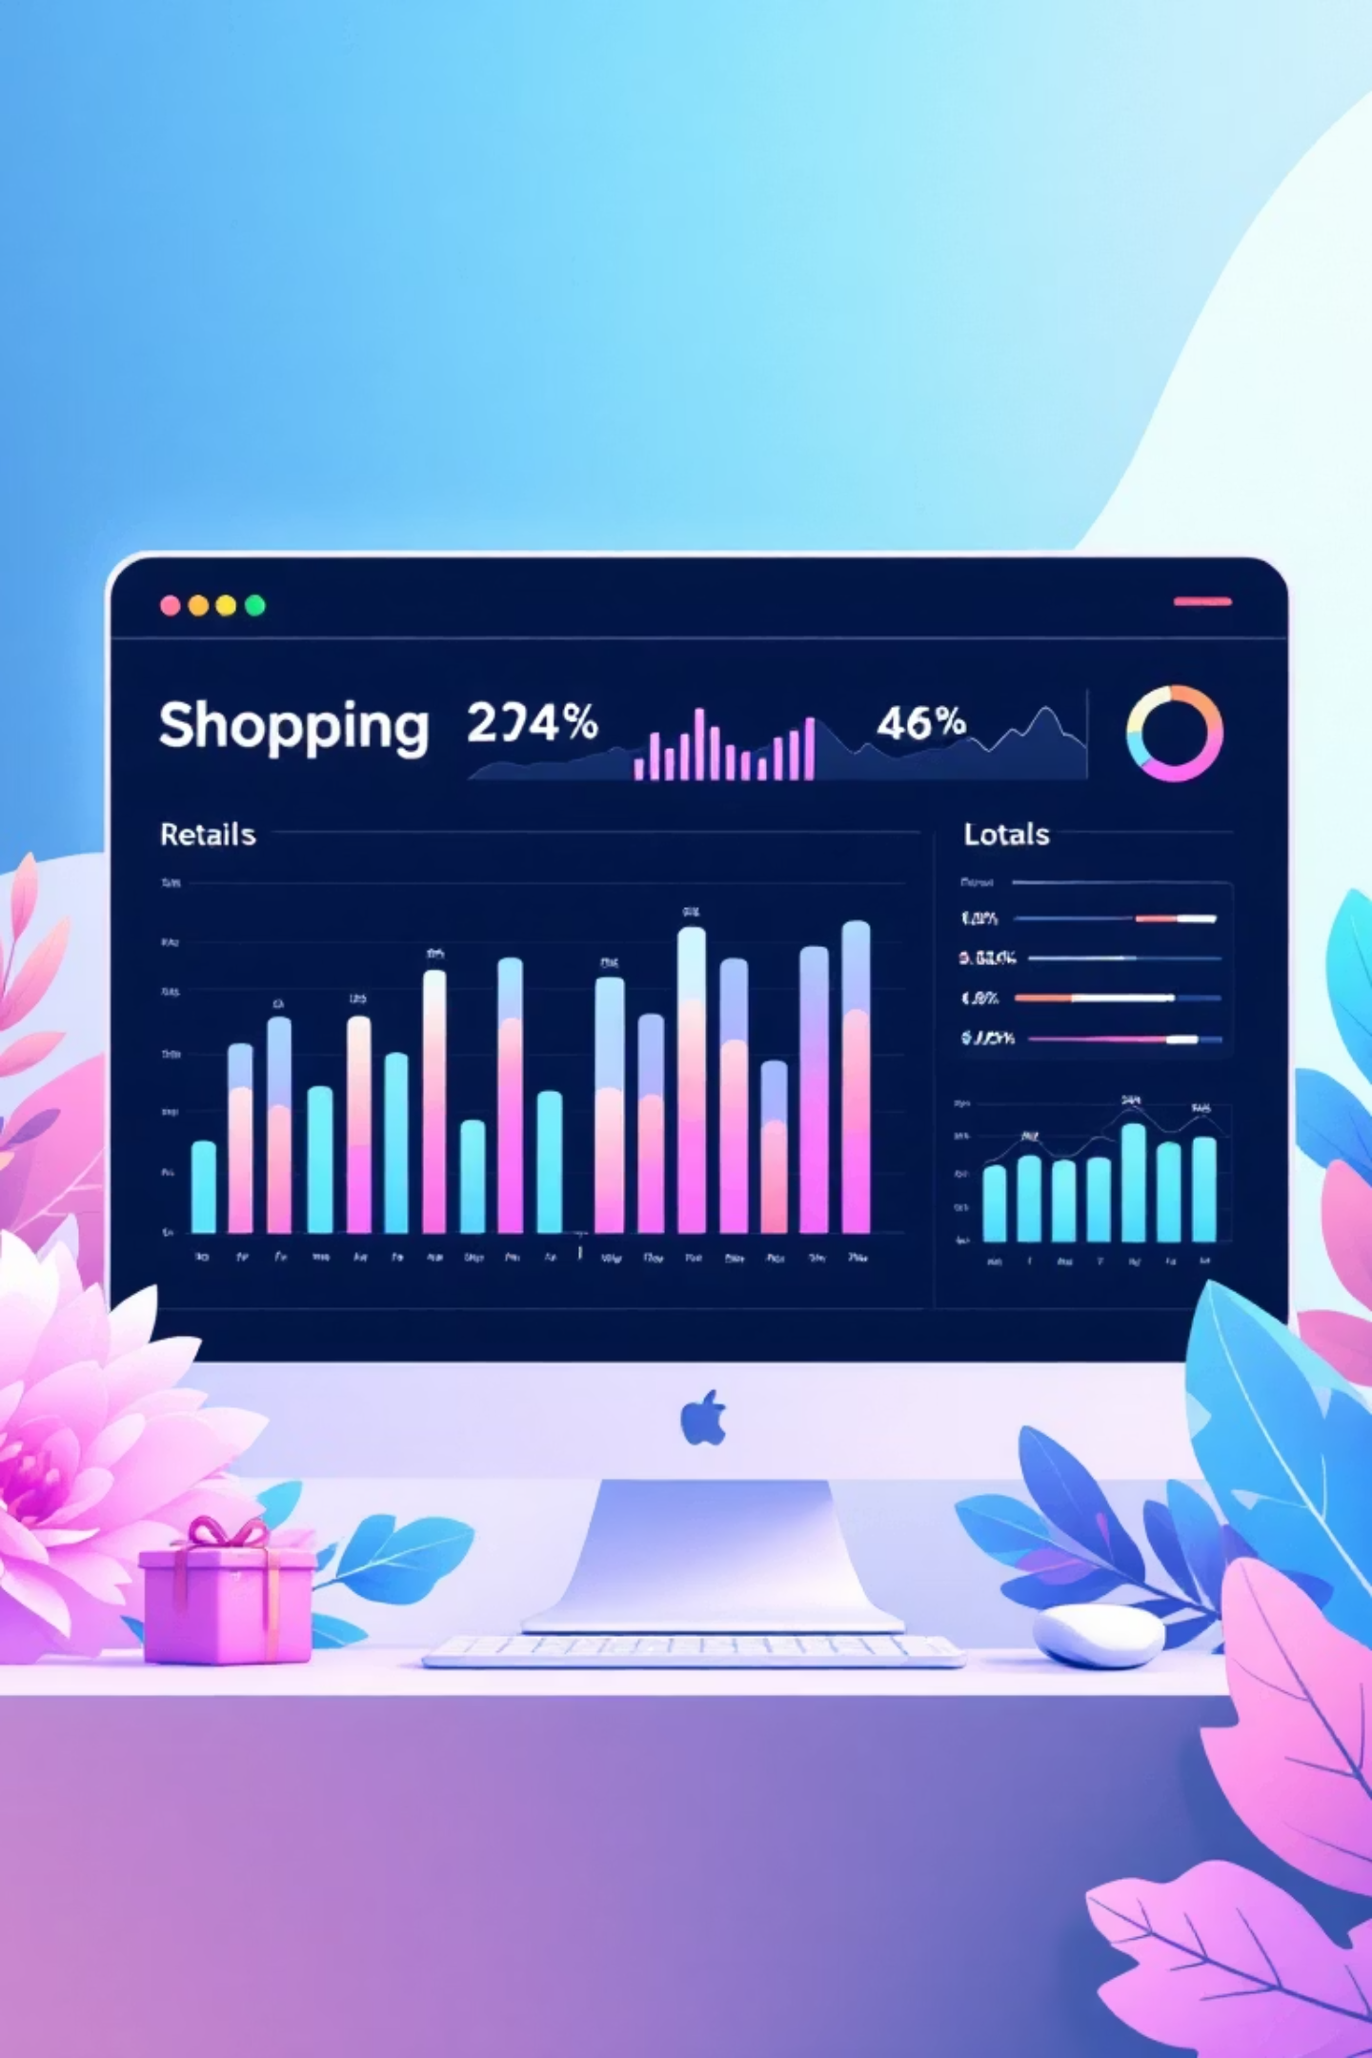
Customer Shopping Behavior Analysis
Uncovering insights from 3,900 purchases to drive strategic business decisions

Slide 2
Project Roadmap
01
02
Project Overview
Dataset Summary
Define goals and scope
Understand data structure
03
04
Python EDA
SQL Analysis
Clean and prepare data
Answer business questions
05
06
Power BI Dashboard
Recommendations
Visualize insights
Drive strategic decisions

Slide 3

Dataset at a Glance
3,900
18
37
Total Purchases
Data Columns
Missing Values
Transaction records analyzed
Rich feature set
Review ratings only
Demographics
Purchase Details
Shopping Behavior
Age, Gender, Location, Subscription Status
Item, Category, Amount, Season, Size, Color
Discounts, Reviews, Shipping, Purchase Frequency

Slide 4

Python Data Preparation
Data Cleaning Steps
Feature Engineering
Loaded dataset with pandas
Created age_group by binning customer ages
Explored structure with .info() and .describe()
Generated purchase_frequency_days from transaction data
Imputed missing Review Ratings using median by category
Connected to PostgreSQL for SQL analysis
Standardized columns to snake_case
Dropped redundant promo_code_used column

Slide 5


Revenue Insights
51%
49%
Male Customers
Female Customers
Slightly higher revenue contribution
Nearly equal spending power
Shipping Type Impact
High-Value Discount Users
Express shipping customers spend more on average than Standard shipping users
Many customers using discounts still exceed average purchase amounts

Slide 6
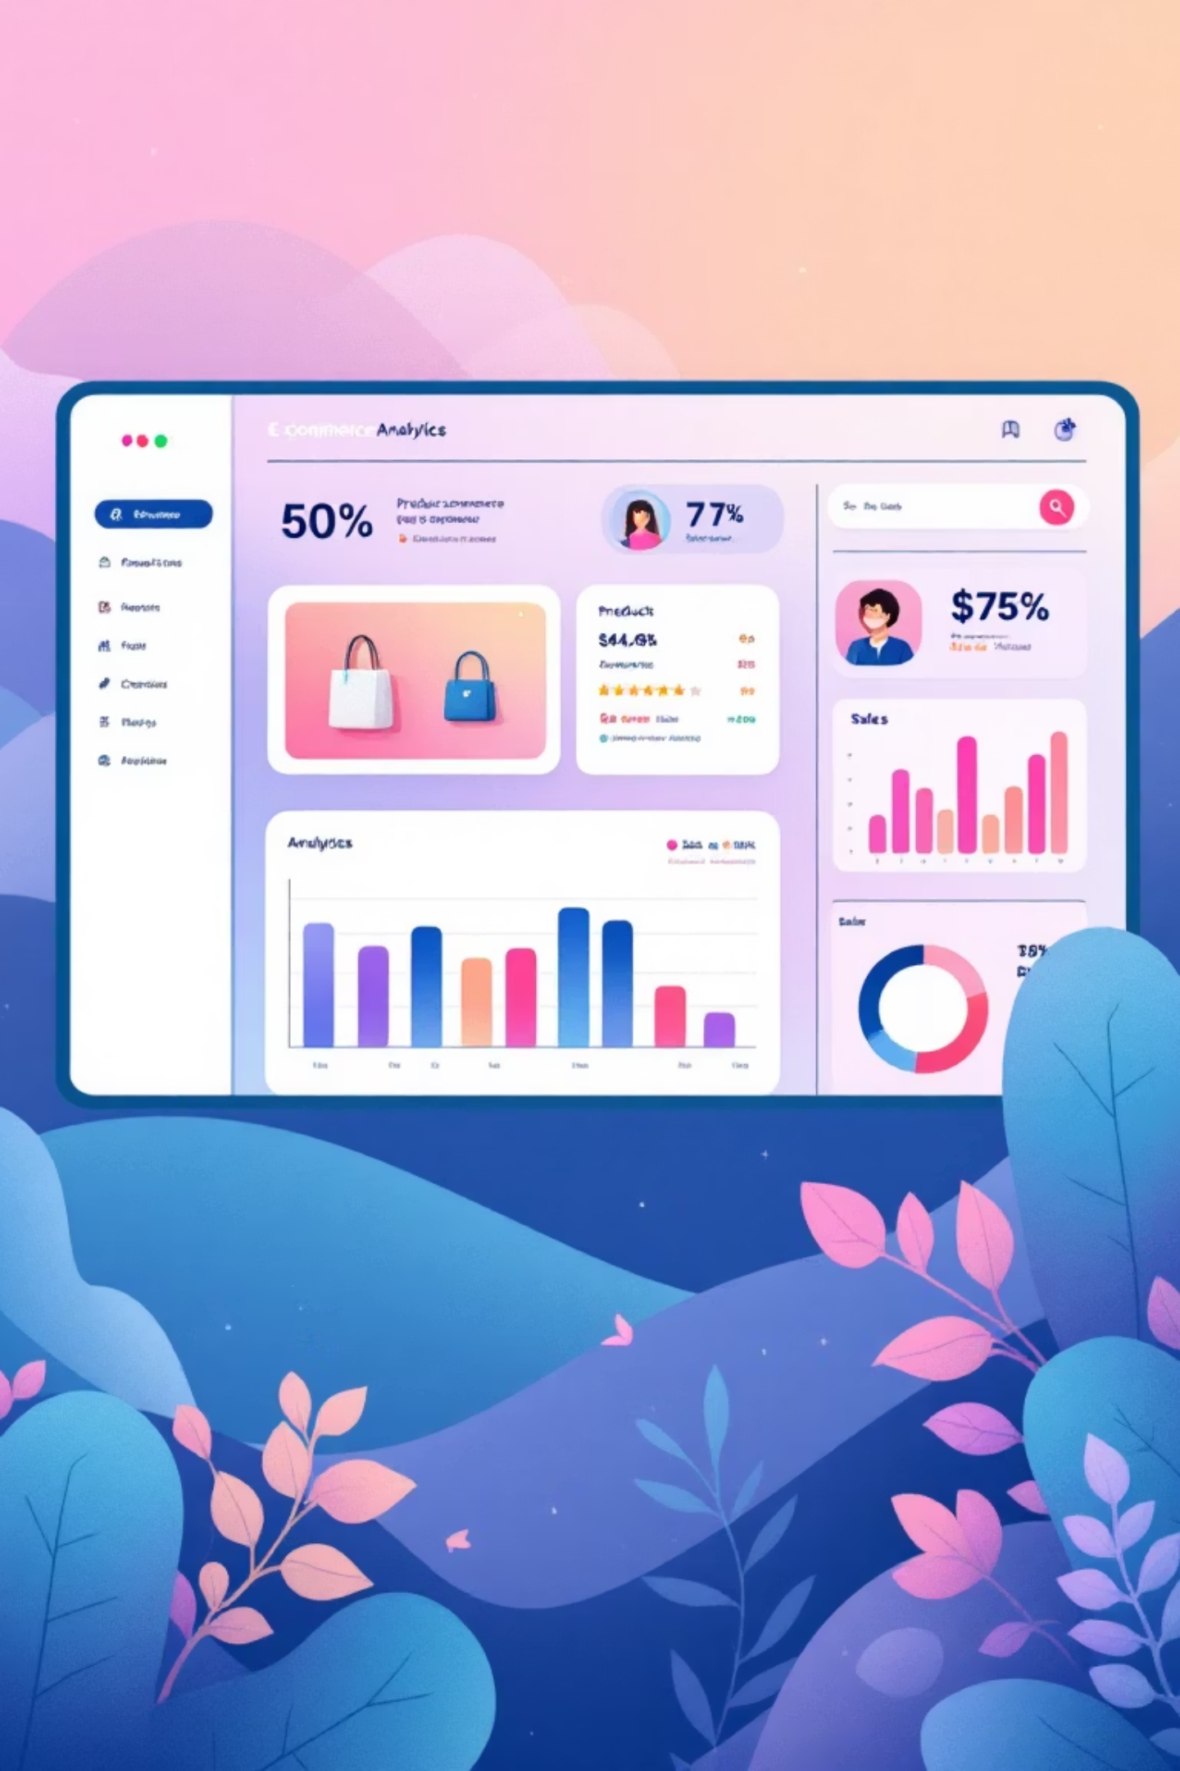
Product Performance
1
2
Top-Rated Products
Best-Sellers by Category
Identified 5 products with highest average review ratings
Top 3 most purchased products within each category
3
Discount-Dependent Items
5 products with highest percentage of discounted purchases

Slide 7




Customer Segmentation
Loyal
1
Frequent buyers
Returning
2
Repeat customers
New
3
First-time shoppers
Customers classified based on purchase history and frequency patterns
Key Finding: Customers with 5+ purchases show higher subscription rates

Slide 8
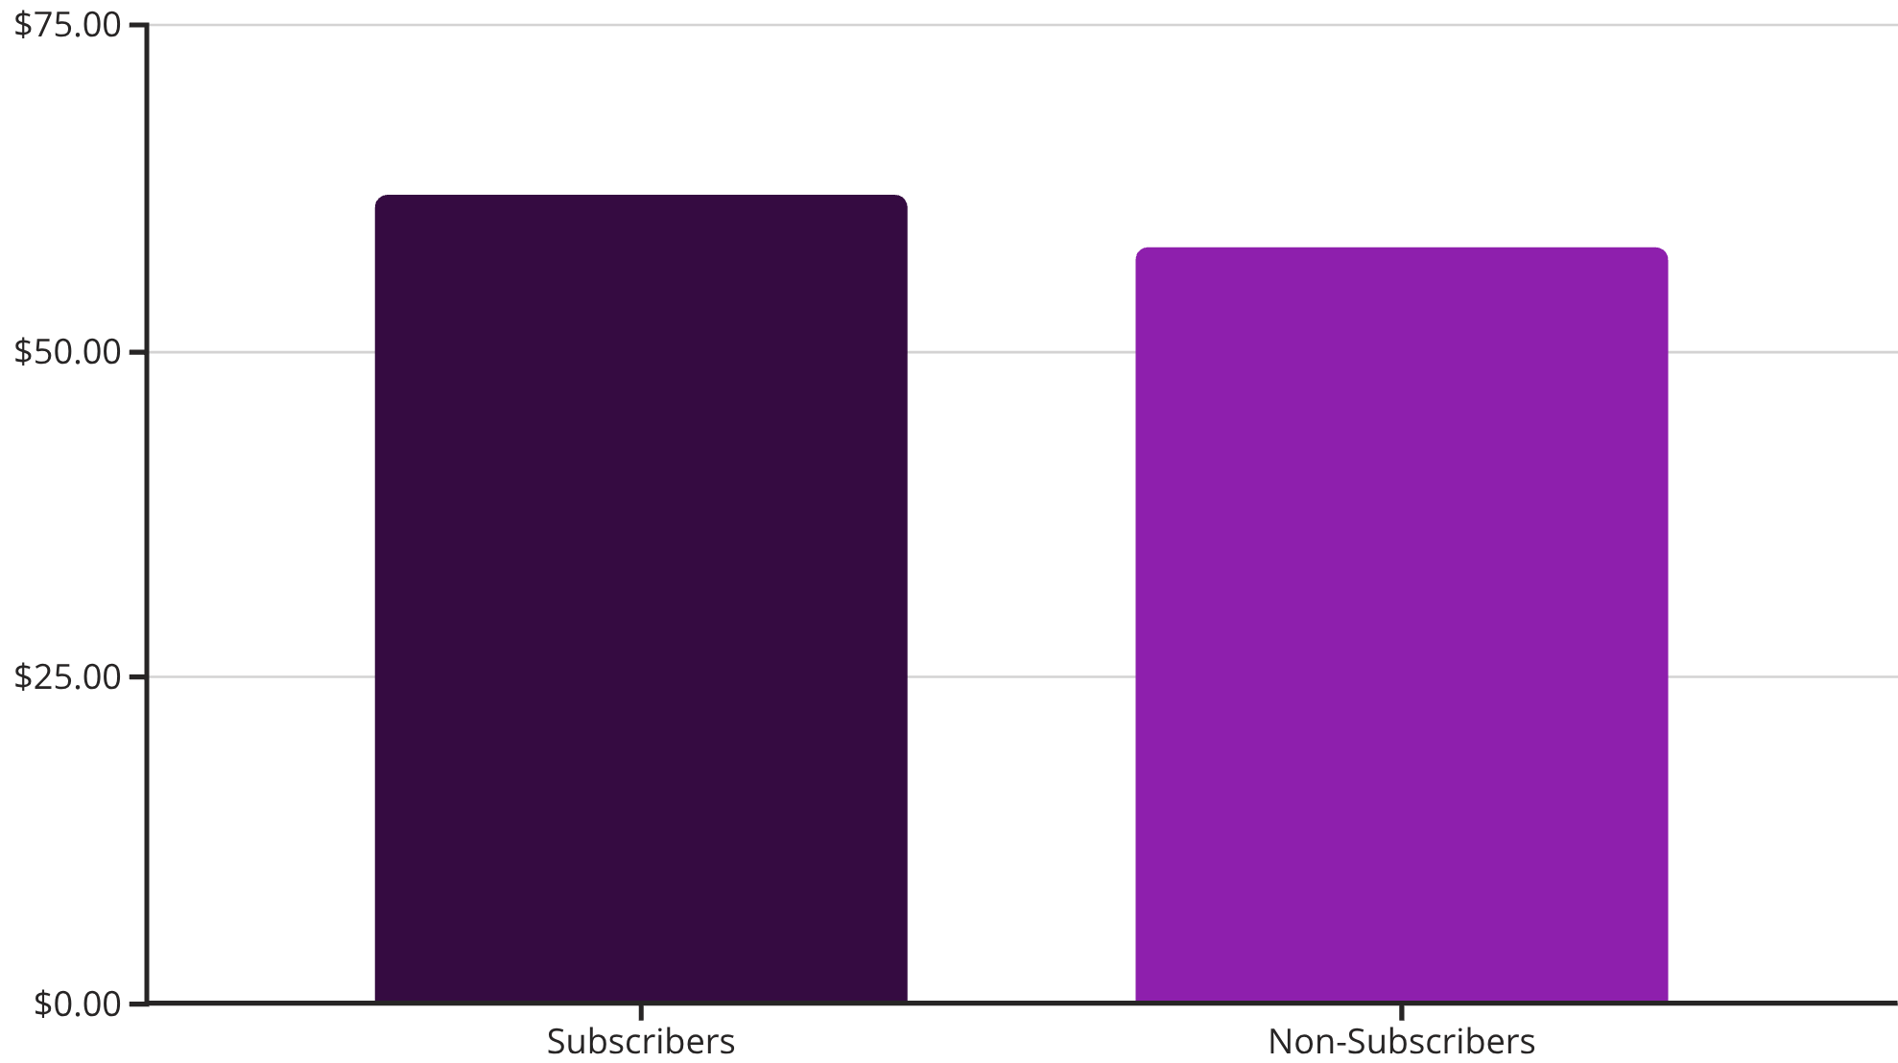
Subscription Analysis
Subscriber Advantage
Subscribers spend more per transaction and generate higher total revenue
Repeat buyers (5+ purchases) more likely to subscribe

Slide 9


Power BI Dashboard
Visual Insights
Dynamic Filtering
KPI Tracking
Interactive charts reveal spending patterns and trends
Slice data by demographics, categories, and time periods
Monitor key metrics and business performance indicators

Slide 10
Strategic Recommendations
Boost Subscriptions
Loyalty Programs
Review Discounts
Promote exclusive benefits for subscribers to increase recurring revenue
Reward repeat buyers to move them into "Loyal" segment
Balance sales boosts with margin control for profitability
Product Positioning
Targeted Marketing
Highlight top-rated and best-selling products in campaigns
Focus on high-revenue age groups and express-shipping users

